Slide 1

IMS
By Tashfeen Arshad

Slide 2
My Metholody
Reverse Engineer the problerm
Runner>IMS>CurdController>CustomerCURDcontroller>Exceptions> persistance_DAO>persistance_domain. The way the problem is called so to make new items and orders just work backwords
persistance_domain>DAO>exceptions> CustomerCURDcontroller> CurdController>IMS>Runner

Slide 3
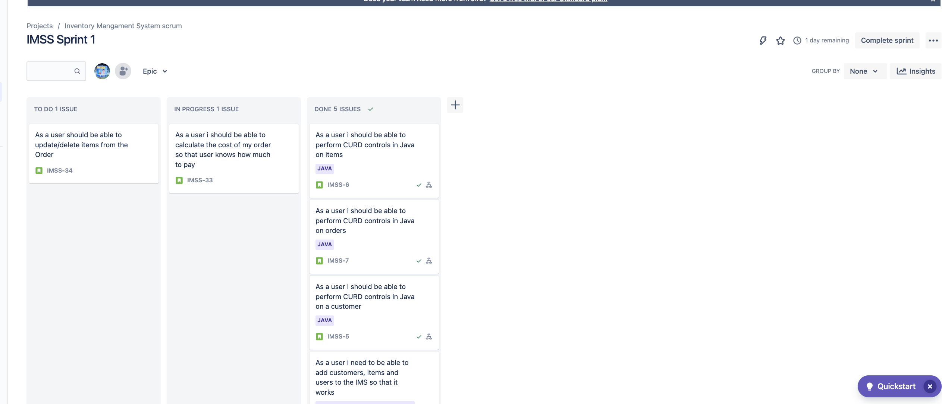
JIra
Used 2 EPICs-one for MySQL and another for JAVA. Each story then had subtasks that I need to do inorder to complete the project

Slide 4
Risk ASSessment
Ref | Risk Description | Cause | Risk Event | Likelihood (1-5) | Impact (1-5) | Risk rating | Action
1 | Lack of Time | Improper time management | Not completing project/task | 1 1 | 4 | 4 | Plan daily tasks and set deadlines
2 | Self-Management | Burnout | Not being able to complete work, physical illness | 2 | 3 | 7 | Take regular breaks, set realistic goals, ask for help when needed
3 | Heat wave | Climate change | Overheating | 5 | 3 | 7 | Have fans and take regular breaks
4 | Computer dying | Poor Hardware | Loss of work, stress and can impact future work | 2 | 4 | 9 | Keep multiple backups of work on the server
5 | Internet loss | Remote location, poor infrastructure | Unable to connect to the cloud or be able to use online resources | 3 | 2 | 2 | Save database to local machine & online. Make sure to have a steady connection wherever I am working

Slide 5
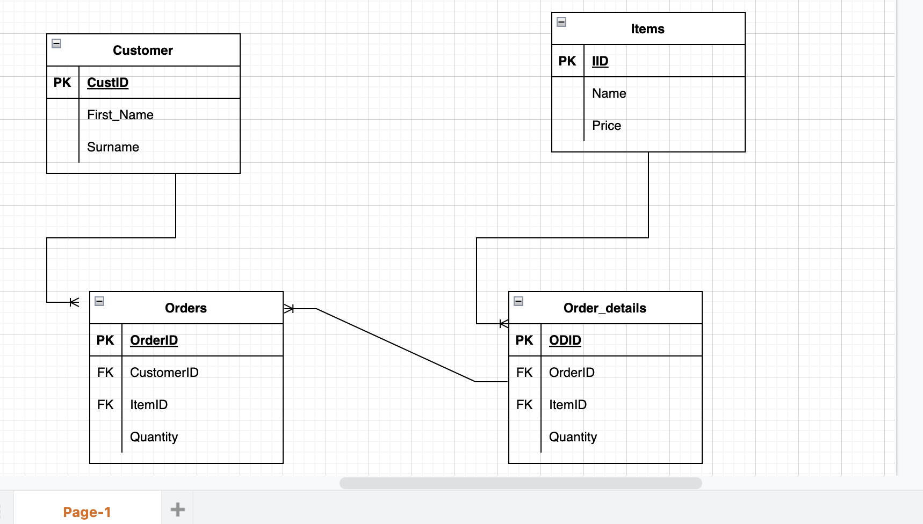
ERD
Realtionships
Customers to Order-one to MANY
Item to Order_details-one to MANY
Order to Order_details-one to MANY

